Slide 1
Principles of Distributed Database Systems
M. Tamer Özsu
Patrick Valduriez

Slide 2
Outline
Introduction
Distributed and Parallel Database Design
Distributed Data Control
Distributed Query Processing
Distributed Transaction Processing
Data Replication
Database Integration – Multidatabase Systems
Parallel Database Systems
Peer-to-Peer Data Management
Big Data Processing
NoSQL, NewSQL and Polystores
Web Data Management

Slide 3
Outline
Big Data Processing
Distributed storage systems
Processing platforms
Stream data management
Graph analytics
Data lake

Slide 4
Four Vs
Volume
Increasing data size: petabytes (10¹⁵) to zettabytes (10²¹)
Variety
Multimodal data: structured, images, text, audio, video
90% of currently generated data unstructured
Velocity
Streaming data at high speed
Real-time processing
Veracity
Data quality

Slide 5
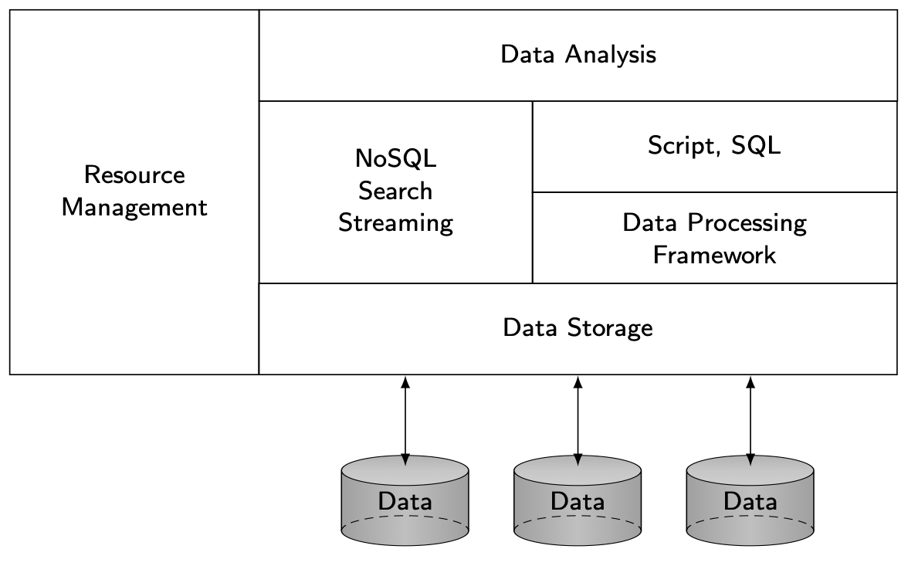
Big Data Software Stack

Slide 6
Outline
Big Data Processing
Distributed storage systems
Processing platforms
Stream data management
Graph analytics

Slide 7
Distributed Storage System
Storing and managing data across the nodes of a shared-nothing cluster
Object-based
Object = ⟨oid, data, metadata⟩
Metadata can be different for different object
Easy to move
Flat object space → billions/trillions of objects
Easily accessed through REST-based API (get/put)
Good for high number of small objects (photos, mail attachments)
File-based
Data in files of fixed- or variable-length records
Metadata-per-file stored separately from file
For large data, a file needs to be partitioned and distributed

Slide 8
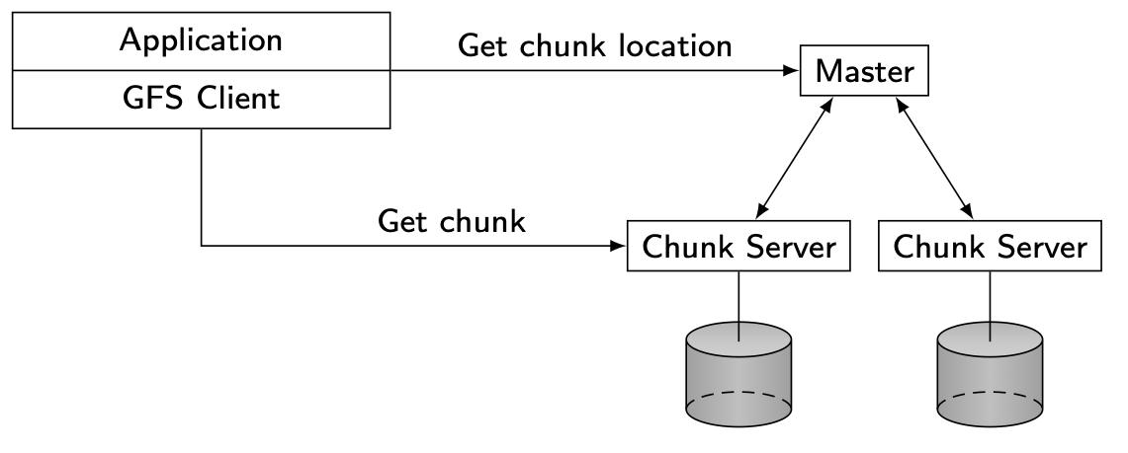
Google File System (GFS)
Targets shared-nothing clusters of thousands of machines
Targets applications with characteristics:
Very large files (several gigabytes)
Mostly read and append workloads
High throughput more important than low latency
Interface: create, open, read, write, close, delete, snapshot, record append

Slide 9
Outline
Big Data Processing
Distributed storage systems
Processing platforms
Stream data management
Graph analytics

Slide 10
Big Data Processing Platforms
Applications that do not need full DBMS functionality
Data analysis of very large data sets
Highly dynamic, irregular, schemaless, …
“Embarrassingly parallel problems”
MapReduce/Spark
Advantages
Flexibility
Scalability
Efficiency
Fault-tolerance
Disadvantage
Reduced functionality
Increased programming effort

Slide 11
MapReduce Basics
Simple programming model
Data structured as (key, value) pairs
E.g. (doc-id, content); (word, count)
Functional programming style with two functions
map(k1, v1) → list(k2, v2)
reduce(k2, list(v2)) → list(v3)
Implemented on a distributed file system (e.g. Google File System) on very large clusters

Slide 12
map Function
User-defined function
Processes input (key, value) pairs
Produces a set of intermediate (key, value) pairs
Executes on multiple machines (called mapper)
map function I/O
Input: read a chunk from distributed file system (DFS)
Output: Write to intermediate file on local disk
MapReduce library
Execute map function
Groups together all intermediate values with same key
Passes these lists to reduce function
Effect of map function
Processes and partitions input data
Builds a distributed map (transparent to user)
Similar to “group by” operator in SQL

Slide 13
reduce Function
User-defined function
Accepts one intermediate key and a set of values for that key (i.e. a list)
Merges these values together to form a (possibly) smaller set
Computes the reduce function generating, typically, zero or one output per invocation
Executes on multiple machines (called reducer)
reduce function I/O
Input: read from intermediate files using remote reads on local files of corresponding mappers
Output: Write result back to DFS
Effect of map function
Similar to aggregation function in SQL

Slide 14
Example
Consider EMP(ENO,ENAME,TITLE,CITY)
SELECT CITY, COUNT(*)
FROM EMP
WHERE ENAME LIKE “%Smith”
GROUP BY CITY
map (Input: (TID,EMP), Output: (CITY, 1)
if EMP.ENAME like ``\%Smith’’ return (CITY, 1)
reduce (Input: (CITY, list(1)), Output: (CITY, SUM(list)))
return (CITY, SUM(1))

Slide 15
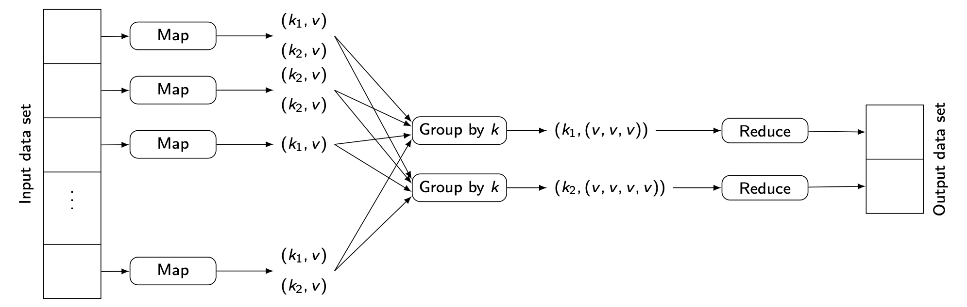
MapReduce Processing

Slide 16
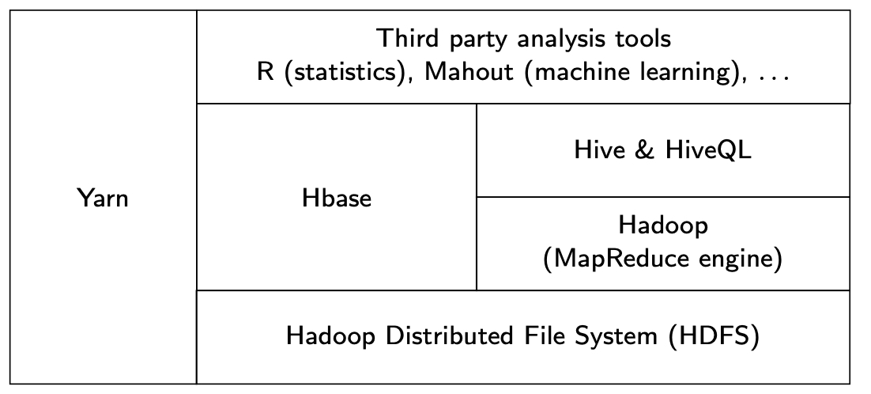
Hadoop Stack

Slide 17
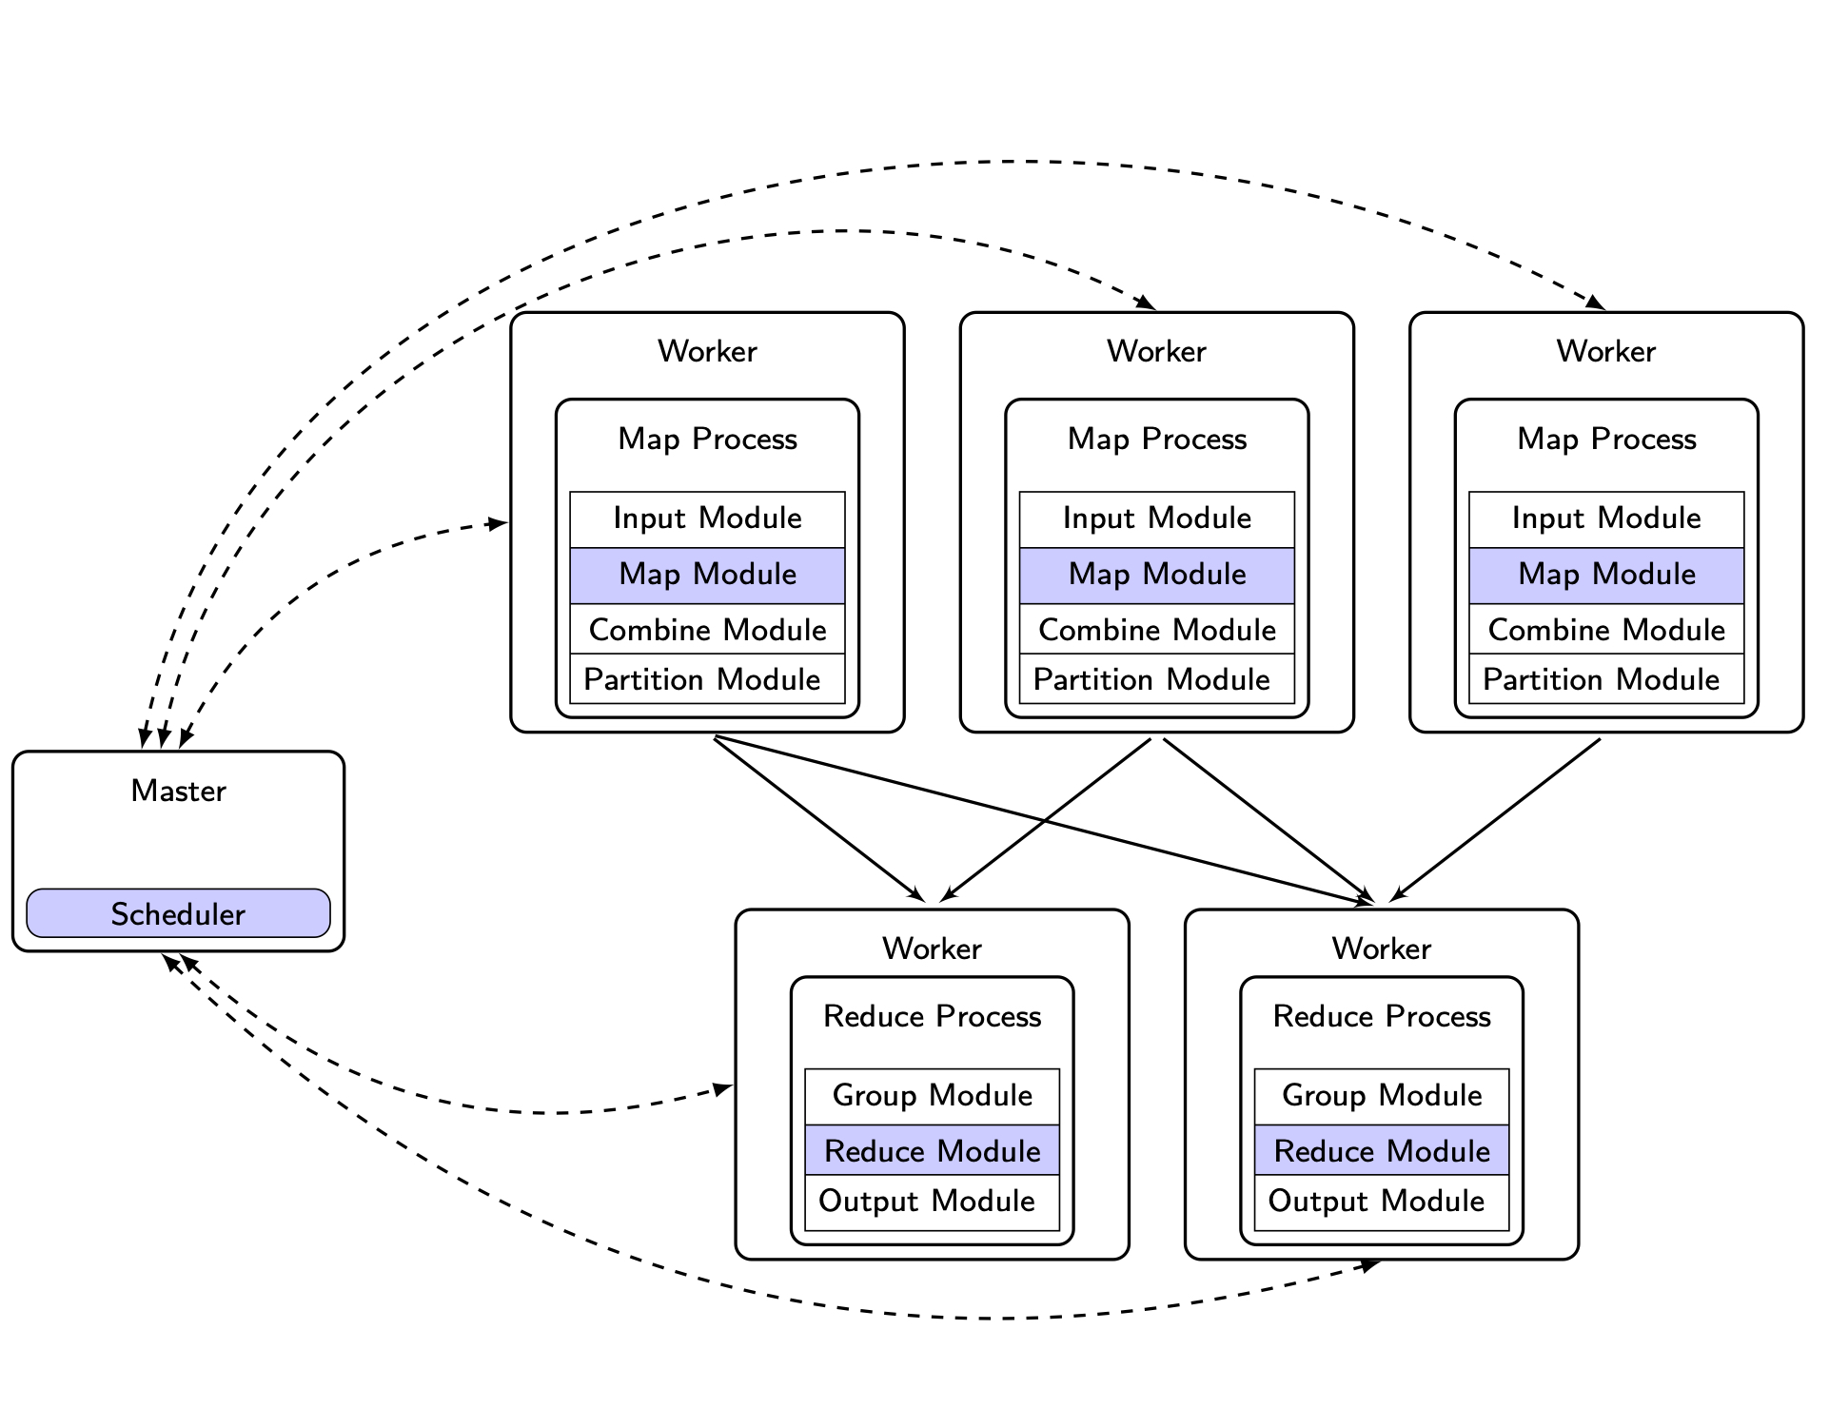
Master-Worker Architecture

Slide 18
Execution Flow
From: J. Dean and S.Ghemawat. MapReduce: Simplified data processing on large clusters, Comm. ACM, 51(1), 2008.

Slide 19
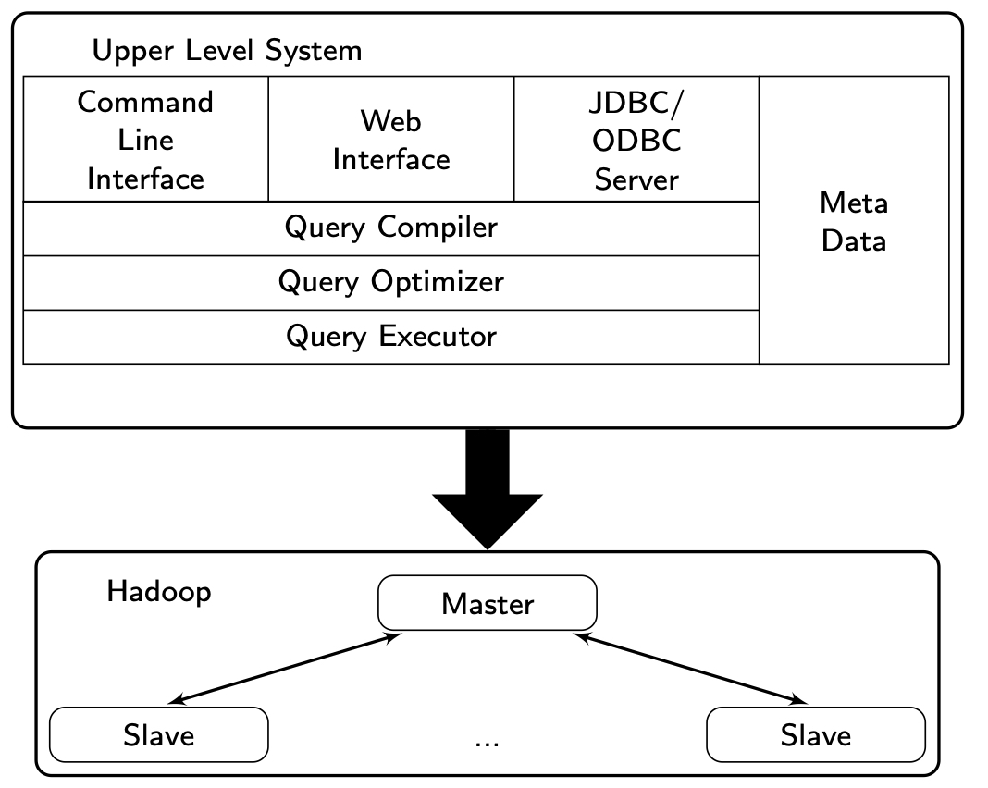
High-Level MapReduce Languages
Declarative
HiveQL
Tenzing
JAQL
Data flow
Pig Latin
Procedural
Sawzall
Java Library
FlumeJava

Slide 20
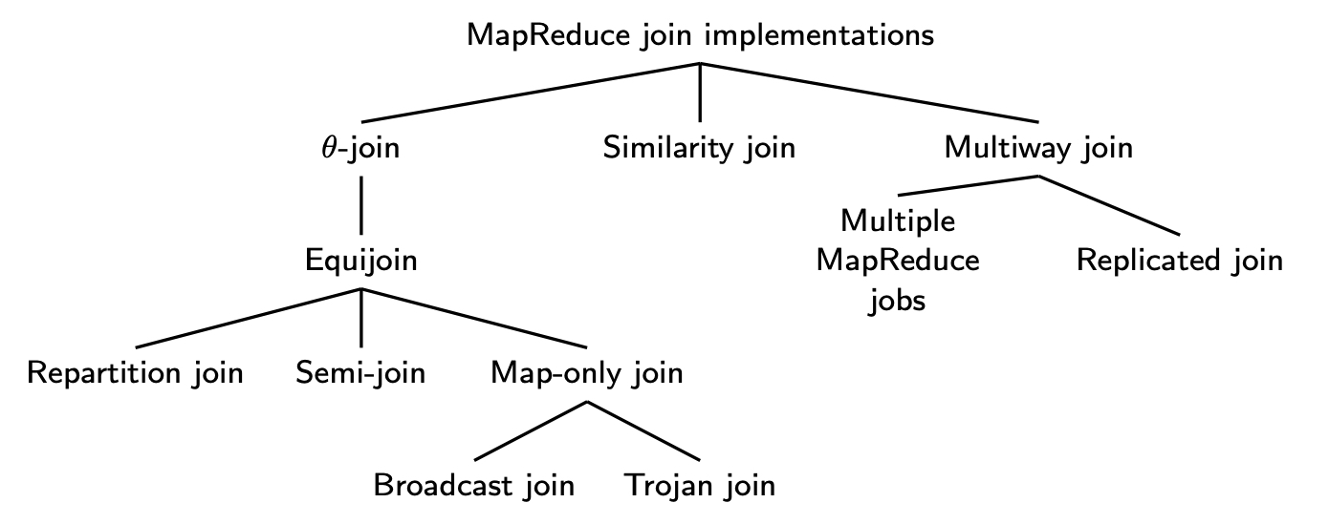
MapReduce Implementations of DB Ops
Select and Project can be easily implemented in the map function
Aggregation is not difficult (see next slide)
Join requires more work

Slide 21
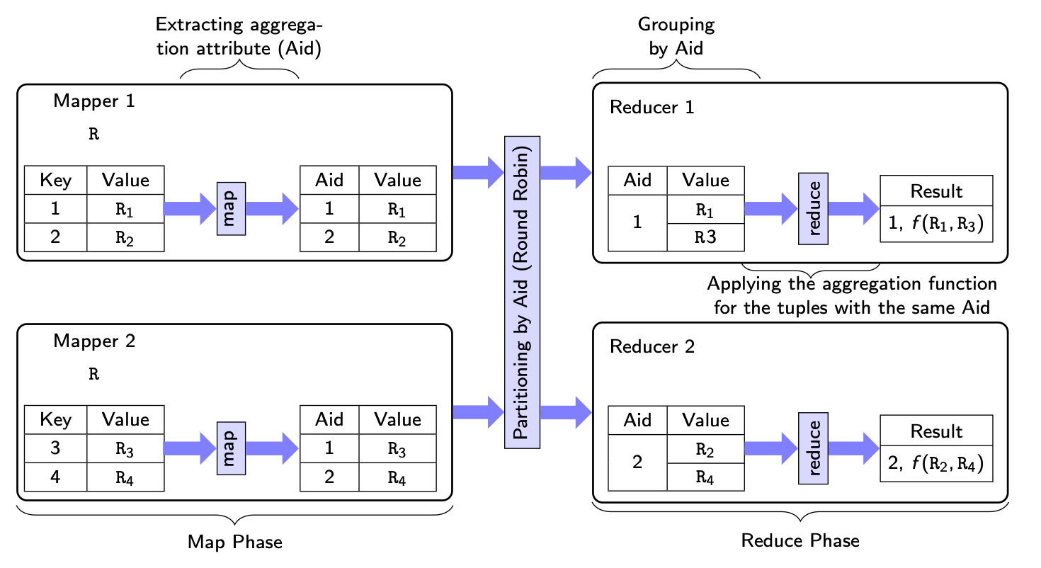
Aggregation

Slide 22
𝜃-Join
Baseline implementation of R(A,B) ⨝ S(B,C)
Partition R and assign each partition to mappers
Each mapper takes ⟨a,b⟩ tuples and converts them to a list of key-value pairs of the form (b, ⟨a,R⟩)
Each reducer pulls the pairs with the same key
Each reducer joins tuples of R with tuples of S

Slide 23
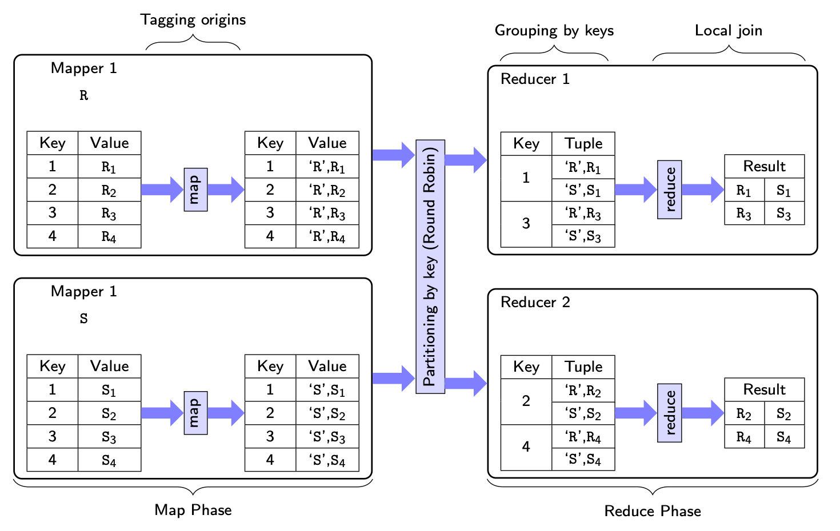
𝜃-Join (𝜃 is =)
Repartition join

Slide 24
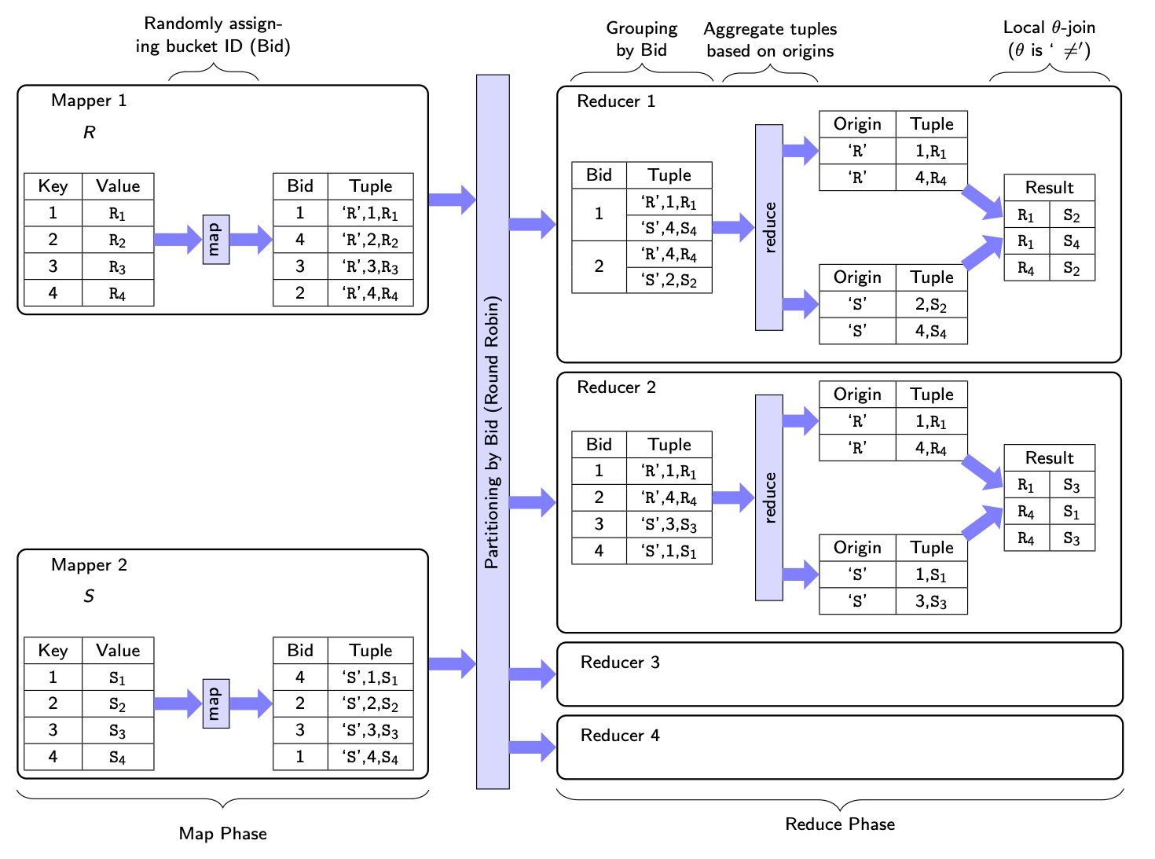
𝜃-Join (𝜃 is ≠)

Slide 25
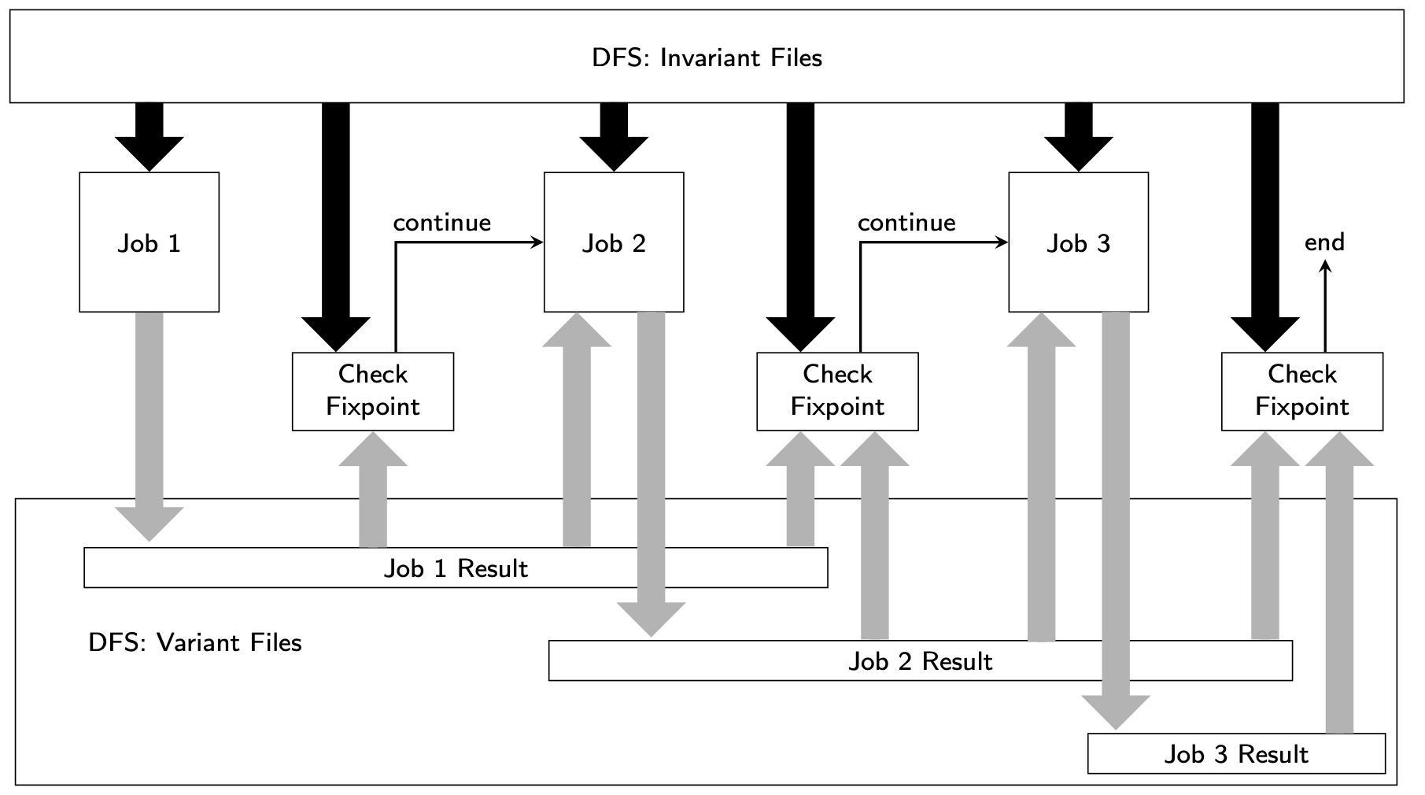
MapReduce Iterative Computation

Slide 26
Problems with Iteration
MapReduce workflow model is acyclic
Iteration: Intermediate results have to be written to HDFS after each iteration and read again
At each iteration, no guarantee that the same job is assigned to the same compute node
Invariant files cannot be locally cached
Check for fixpoint
At the end of each iteration, another job is needed

Slide 27
Spark
Addresses MapReduce shortcomings
Data sharing abstraction: Resilient Distributed Dataset (RDD)
Cache working set (i.e. RDDs) so no writing-to/reading-from HDFS
Assign partitions to the same machine across iterations
Maintain lineage for fault-tolerance

Slide 28
Spark Program Flow

Slide 29
Outline
Big Data Processing
Distributed storage systems
Processing platforms
Stream data management
Graph analytics

Slide 30
Traditional DBMS vs Streaming
DBMS
Streaming
Other differences
Push-based (data-driven)
Persistent queries
Sss
Unbounded stream
System conditions may not be stable

Slide 31
History
Data Stream Management System (DSMS)
Typical DBMS functionality, primarily query language
Earlier systems: STREAM, Gigascope, TelegraphCQ, Aurora, Borealis
Mostly single machine (except Borealis)
Data Stream Processing System (DSPS)
Do not embody DBMS functionality
Later systems: Apache Storm, Heron, Spark Streaming, Flink, MillWheel, TimeStream
Almost all are distributed/parallel systems
Use Data Stream System (DSS) when the distinction is not important

Slide 32
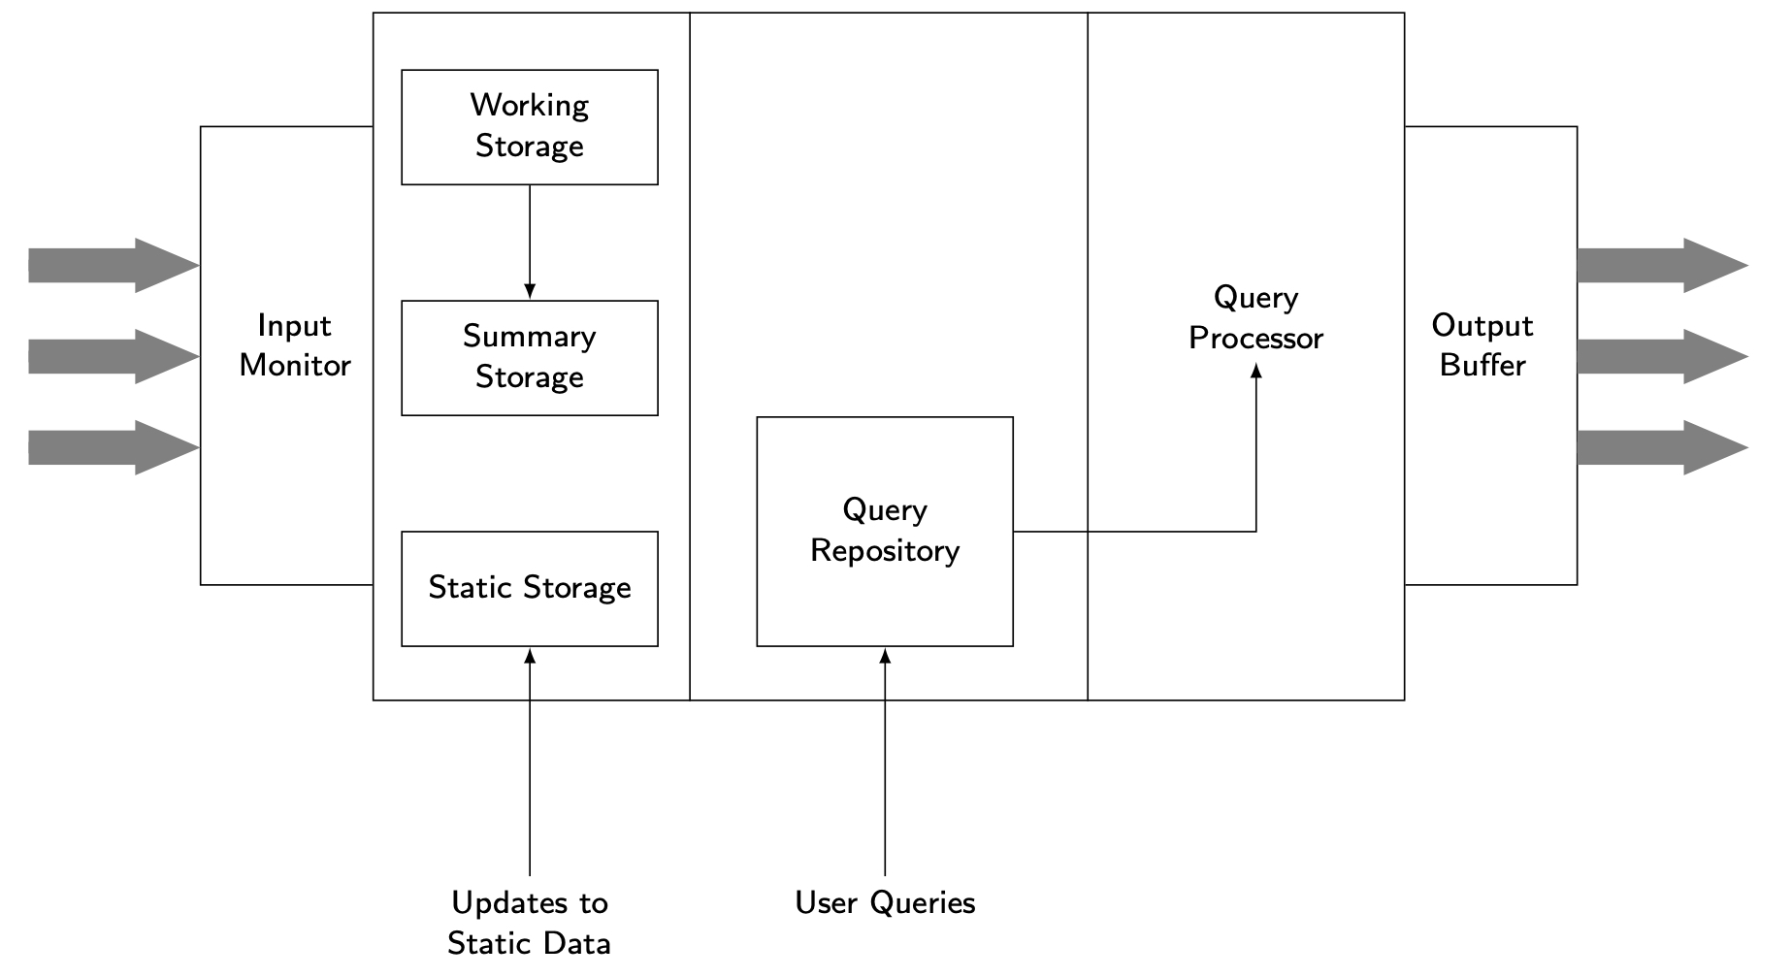
DSMS Architecture

Slide 33
Stream Data Model
Standard def: An append-only sequence of timestamped items that arrive in some order
Relaxations
Revision tuples
Sequence of events that are reported continually (publish/subscribe systems)
Sequence of sets of elements (bursty arrivals)
Typical arrival:
〈timestamp, payload〉
Payload changes based on system
Relational: tuple
Graph: edge
…

Slide 34
Processing Models
Continuous
Each new arrival is processed as soon as it arrives in the system.
Examples: Apache Storm, Heron
Windowed
Arrivals are batched in windows and executed as a batch.
For user, recently arrived data may be more interesting and useful.
Examples: Aurora, STREAM, Spark Streaming

Slide 35
Window Definition
According to the direction of endpoint movement
Fixed window: both endpoints are fixed
Sliding window: both endpoints can slide (backward or forward)
Landmark window: one endpoint fixed, the other sliding
According to definition of window size
Logical window (time-based) – window length measured in time units
Physical window (count-based) – window length measured in number of data items
Partitioned window: split a window into multiple count-based windows
Predicate window: arbitrary predicate defines the contents of the window

Slide 36
Stream Query Models
Queries are typically persistent
They may be monotonic or non-monotonic
Monotonic: result set always grows
Results can be updated incrementally
Answer is continuous, append-only stream of results
Results may be removed from the answer only by explicit deletions (if allowed)
Non-monotonic: some answers in the result set become invalid with new arrivals
Recomputation may be necessary

Slide 37
Stream Query Languages
Declarative
SQL-like syntax, stream-specific semantics
Examples: CQL, GSQL, StreaQuel
Procedural
Construct queries by defining an acyclic graph of operators
Example: Aurora
Windowed languages
size: window length
slide: how frequently the window moves
E.g.: size=10min, slide=5sec
Monotonic vs non-monotonic

Slide 38
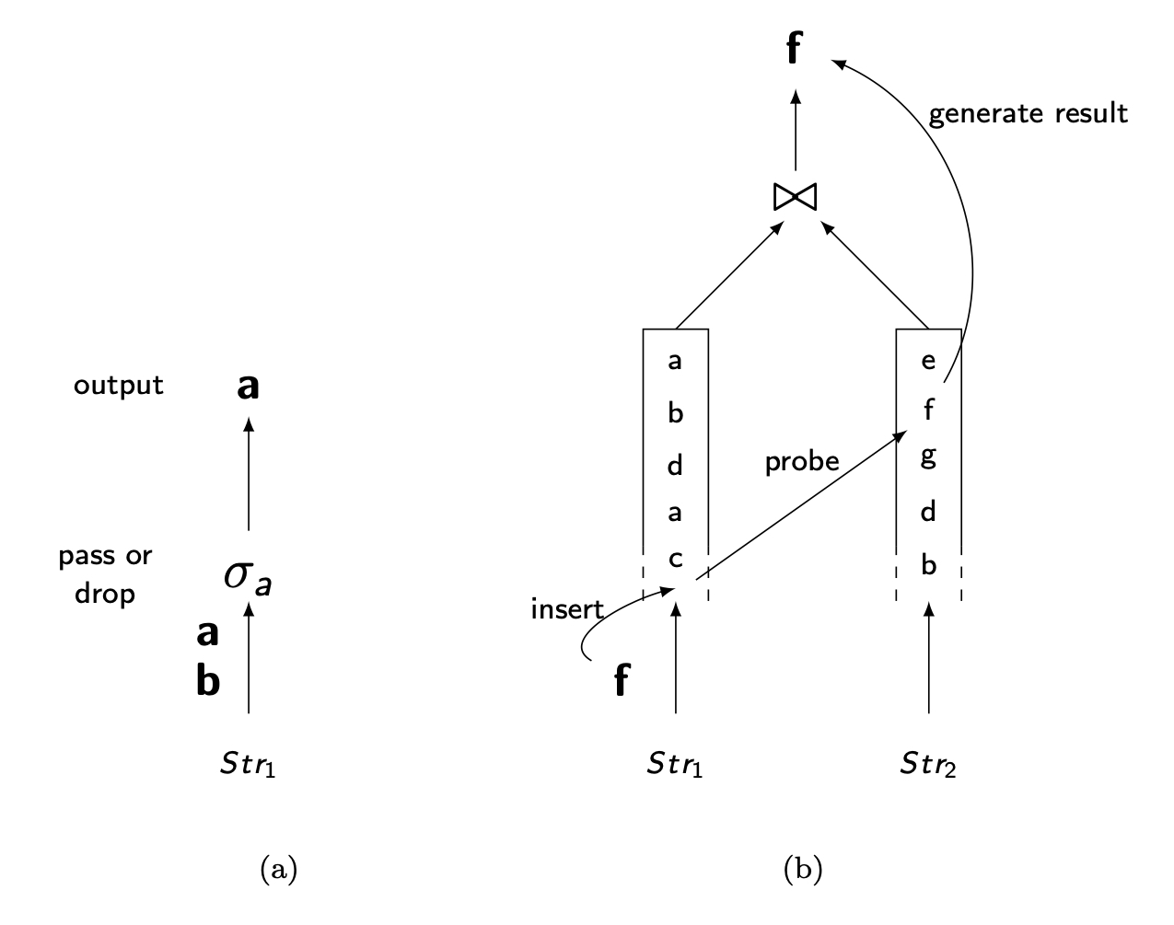
Streaming Operators
Stateless operators are no problem: e.g., selection, projection
Stateful operators (e.g., nested loop join) are blocking
You need to see the entire inner operand
For some blocking operators, non-blocking versions exist (symmetric hash join)
Otherwise: windowed execution

Slide 39
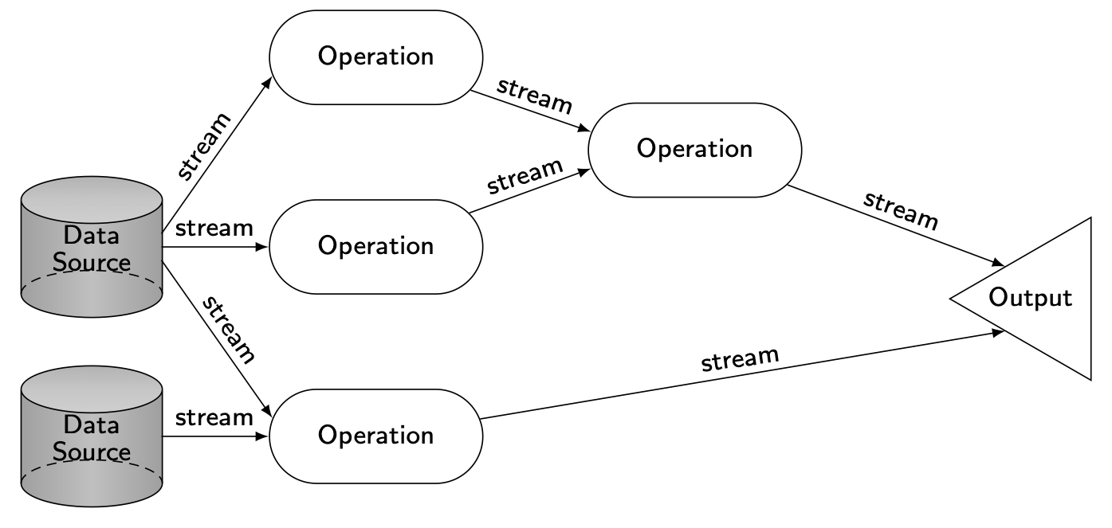
Query Processing over Streams
Similar to relational, except
persistent queries: registered to the system and continuously running
data pushed through the query plan, not pulled
Stream query plan

Slide 40
Query Processing Issues
Continuous execution
Each new arrival is processed as soon as the system gets it
E.g. Apache Storm, Heron
Windowed execution
Arrivals are batched and processed as a batch
E.g. Aurora, STREAM, Spark Streaming
More opportunities for multi-query optimization
E.g. Easier to determine shared subplans

Slide 41
Windowed Query Execution
Two events need to be managed
Arrivals
Expirations
System actions depend on operators
E.g. Join generates new result, negation removes previous result
Window movement also affects results
As window moves, some items in the window move out
What to do to results
If monotonic, nothing; if non-monotonic, two options
Direct approach
Negative tuple approach

Slide 42
Load Management
Stream arrival rate > processing capability
Load shedding
Random
Semantic
Early drop
All of the downstream operators will benefit
Accuracy may be negatively affected
Late drop
May not reduce the system load much
Allows the shared subplans to be evaluated

Slide 43
Out-of-Order Processing
Assumption: arrivals are in timestamp order
May not hold
Arrival order may not match generation order
Late arrivals → no more or just late?
Multiple sources
Approaches
Built-in slack
Punctuations

Slide 44
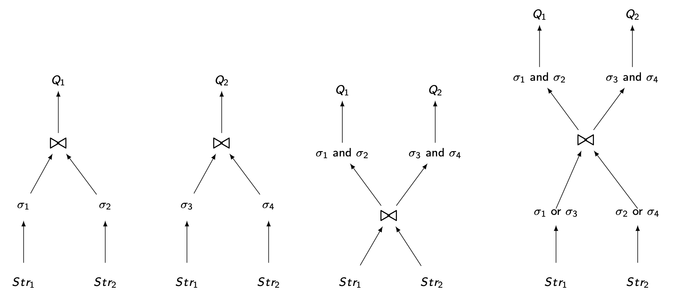
Multiquery Optimization
More opportunity since the persistent queries are known beforehand
Aggregate queries over different window lengths or with different slide intervals
State and computation may be shared (usual)

Slide 45
Parallel Data Stream Processing
Partitioning the incoming stream
Execution of the operation on the partition
(Optionally) aggregation of the results from multiple machines

Slide 46
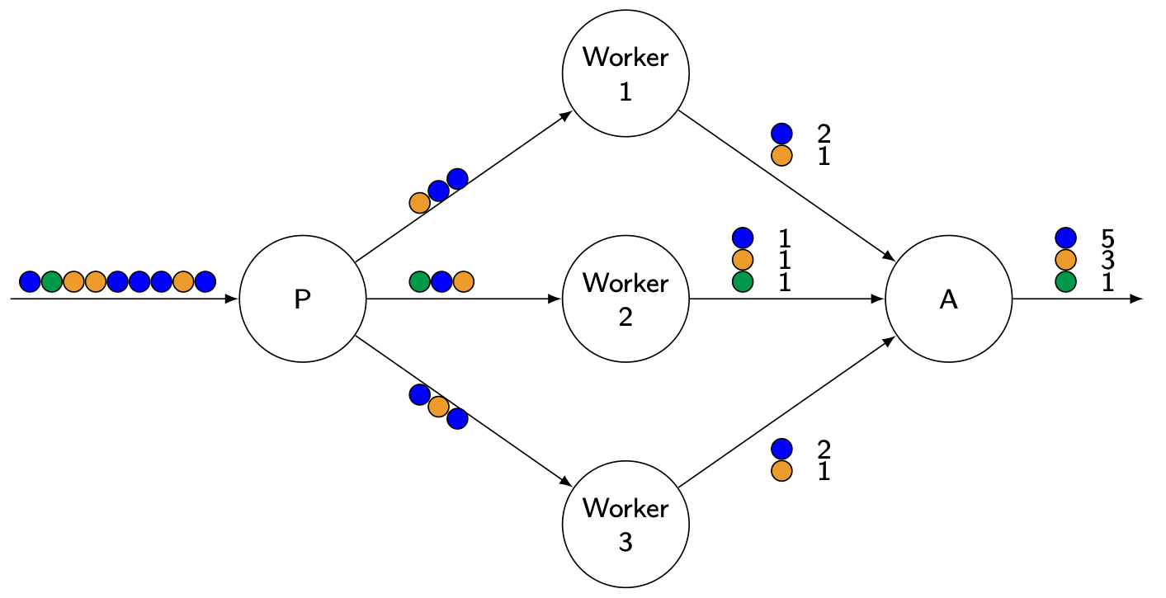
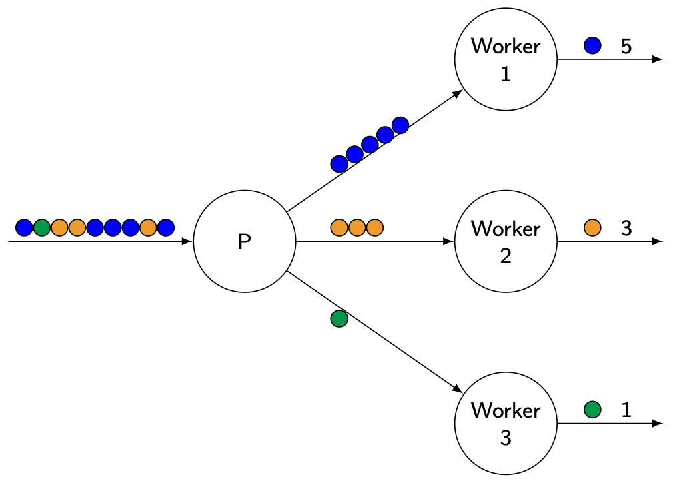
Stream Partitioning
Shuffle (round-robin) partitioning
Hash partitioning

Slide 47
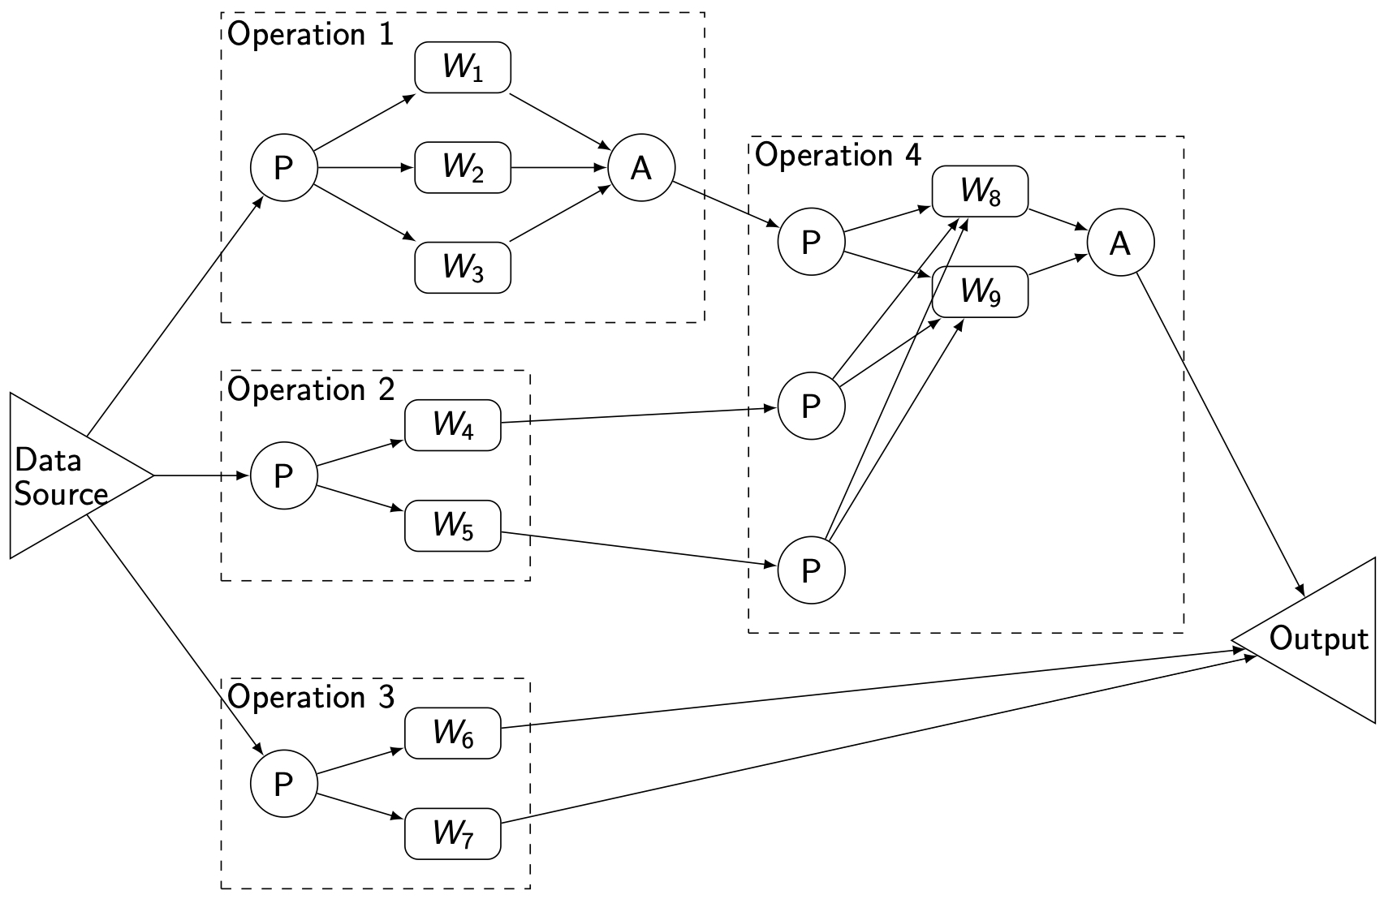
Parallel Stream Query Plan

Slide 48
Outline
Big Data Processing
Distributed storage systems
Processing platforms
Stream data management
Graph analytics

Slide 49
Property Graph
Graph G=(V, E, D_{V}, D_{E}) where V is set of vertices, E is set of edges, D_{V} is set of vertex properties, D_{E} is set of edge properties
Vertices represent entities, edges relationships among them.
Multigraph: multiple edges between a pair of vertices
Weighted graph: edges have weights
Directed vs undirected

Slide 50
Graph Workloads
Analytical
Online
Multiple iterations
Process each vertex at each iteration
Examples
PageRank
Clustering
Connected components
Machine learning tasks
No iteration
Usually access portion of the graph
Examples
Reachability
Single-source shortest path
Subgraph matching

Slide 51
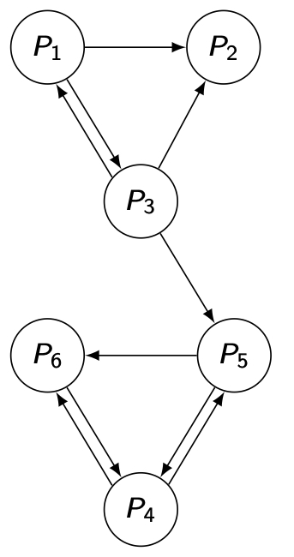
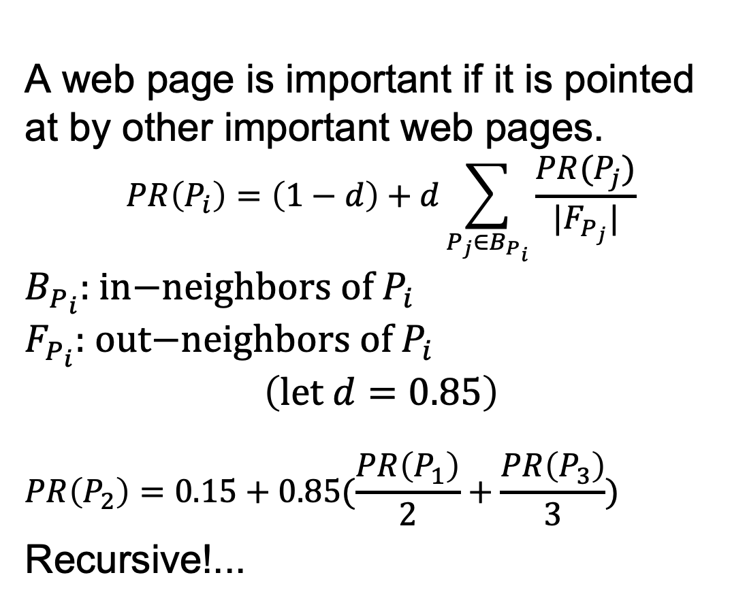
PageRank as Analytical Example
A web page is important if it is pointed at by other important web pages.
$$PR\left(P_{i}\right)=\left(1−d\right)+d\sum_{P_{j}∈B_{P_{i}}}{\frac{PR(P_{j})}{|F_{P_{j}}|}}$$
$$B_{P_{i}}\text{: }\text{in}\text{−}\text{neighbors} \text{of} P_{i}$$
$$F_{P_{i}}\text{: }\text{out}\text{−}\text{neighbors} \text{of} P_{i}$$
$$\left(\text{let} d=0.85\right)$$
$$PR\left(P_{2}\right)=0.15+0.85(\frac{PR\left(P_{1}\right)}{2}+\frac{PR\left(P_{3}\right)}{3})$$
Recursive!...

Slide 52
Graph Partitioning
Graph partitioning is more difficult than relational partitioning because of edges
Two approaches
Edge-cut or vertex-disjoint
Each vertex assigned to one partition, edges may be replicated
Vertex-cut or edge-disjoint
Each edge is assigned to one partition, vertices may be replicated
Objectives
Allocate each vertex/edge to partitions such that partitions are mutually exclusive
Partitions are balanced
Minimize edge-/vertex-cuts to minimize communication

Slide 53
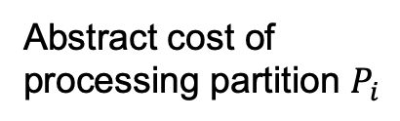
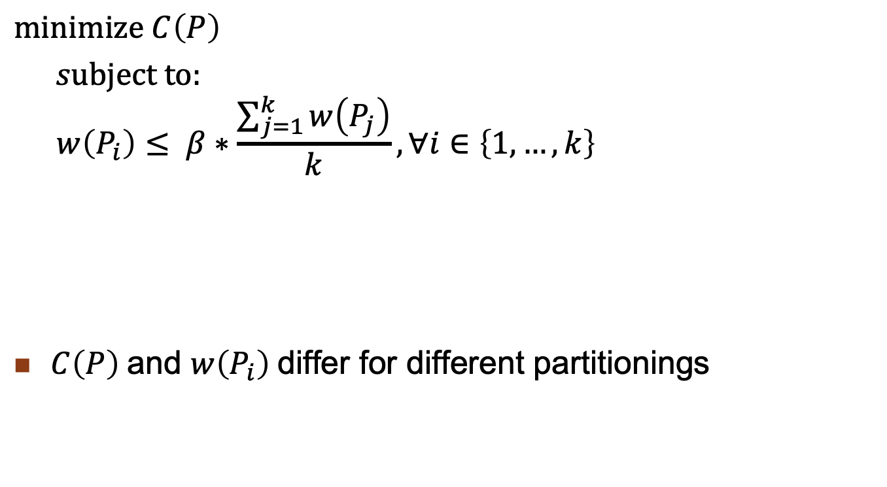
Graph Partitioning Formalization
Total communication cost
due to partitioning
$$\text{minimize} C\left(P\right)$$
$s\text{ubject} \text{to}\text{:}$
$$w\left(P_{i}\right)≤ β∗\frac{\sum_{j=1}^{k}{w\left(P_{j}\right)}}{k}, ∀i∈\left\{1,…,k\right\}$$
$C\left(P\right)$and $w\left(P_{i}\right)$differ for different partitionings
Abstract cost of
processing partition $P_{i}$
Slackness for unbalanced
partitioning

Slide 54
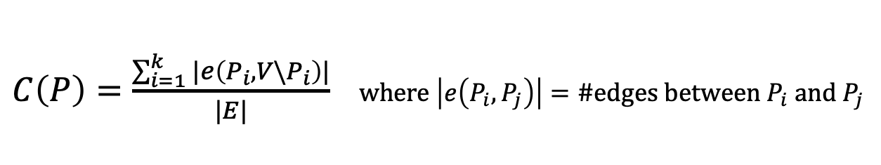
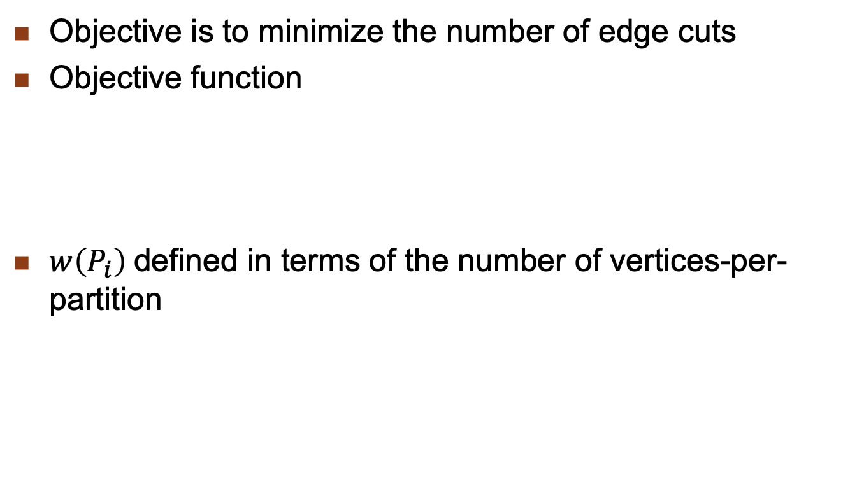
Vertex-Disjoint (Edge-Cut)
Objective is to minimize the number of edge cuts
Objective function
$w\left(P_{i}\right)$defined in terms of the number of vertices-per-partition
$C\left(P\right)=\frac{\sum_{i=1}^{k}{|e\left(P_{i},V\backslash P_{i}\right)|}}{|E|}$ $\text{where} \left|e\left(P_{i},P_{j}\right)\right|=\text{\#}\text{edges} \text{between} P_{i} \text{and} P_{j}$

Slide 55
METIS Vertex-Disjoint Partitioning
METIS is a family of algorithms
Usually the gold standard for comparison
Given an initial graph G₀ = (V, E):
Produce a hierarchy of successively coarsened graphs G₁, …, G_{n} such that |V(G_{i})| > |V(G_{j})| for i < j
Partition G_{n} using some partitioning algorithm
Small enough that it won’t matter what algorithm is used
Iteratively coarsen G_{n} to G₀, and at each step
Project the partitioning solution on graph G_{j} to graph G_{j-1}
Improve the partitioning of G₀

Slide 56
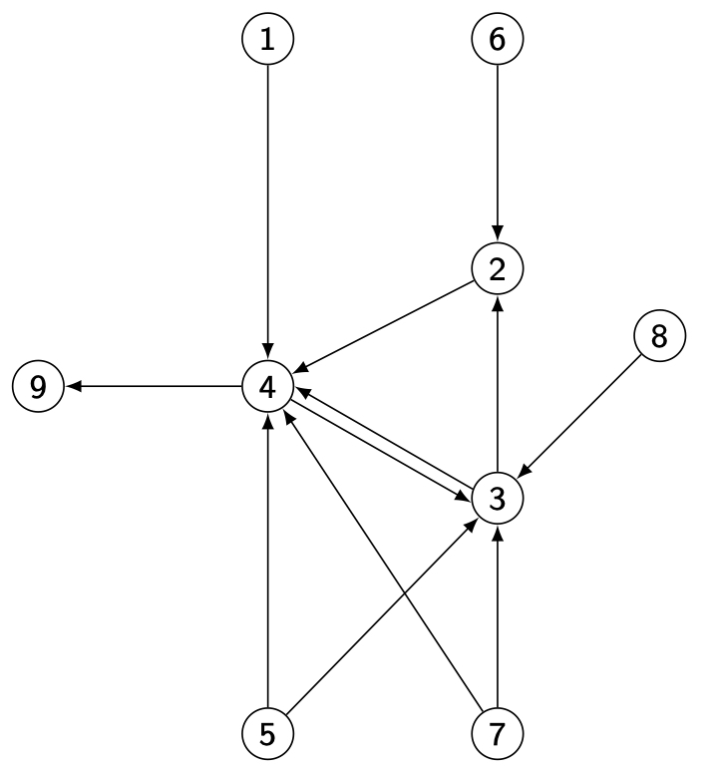
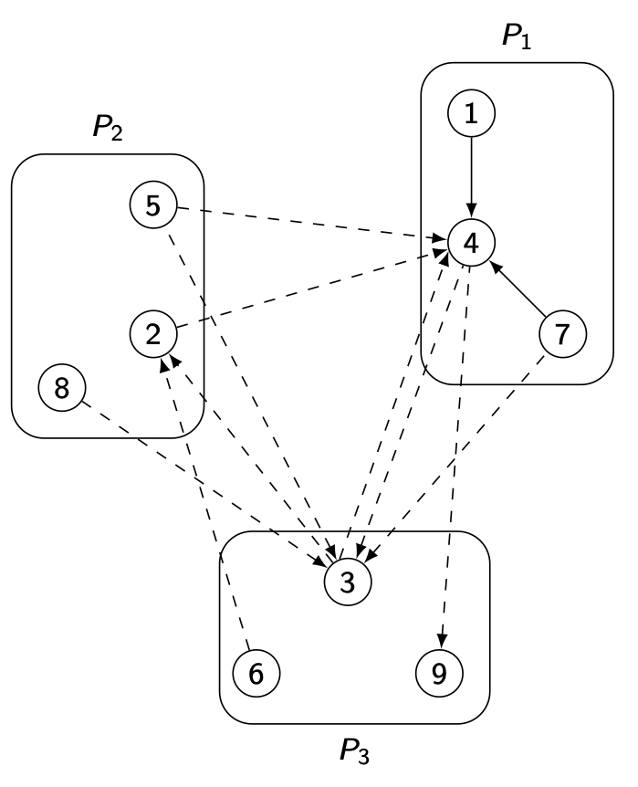
Vertex-Disjoint Partitioning Example
➡

Slide 57
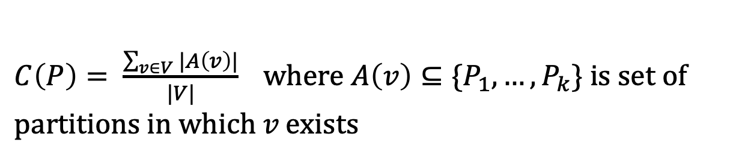
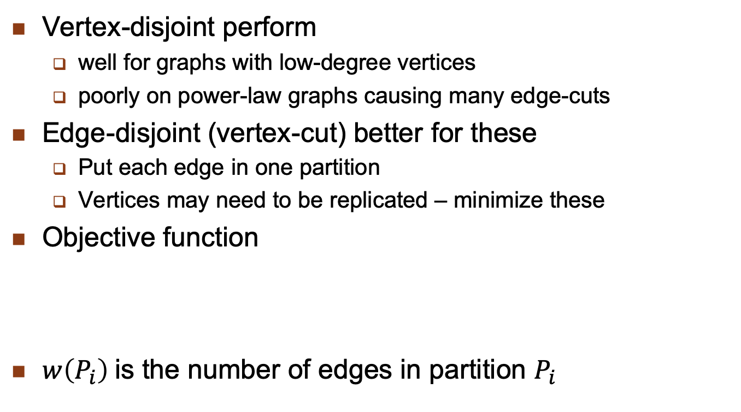
Edge-Disjoint Partitioning
Vertex-disjoint perform
well for graphs with low-degree vertices
poorly on power-law graphs causing many edge-cuts
Edge-disjoint (vertex-cut) better for these
Put each edge in one partition
Vertices may need to be replicated – minimize these
Objective function
$w\left(P_{i}\right)$is the number of edges in partition $P_{i}$
$C\left(P\right)= \frac{\sum_{v∈V}{|A\left(v\right)|}}{|V|}$ $\text{where} A\left(v\right)⊆\{P_{1},…,P_{k}\} \text{is} \text{set} \text{of} \text{partitions} \text{in} \text{which} v \text{exists}$

Slide 58
Edge-Disjoint Alternatives
Hashing (on the ids of the two vertices incident on edge)
Fast and highly parallelizable
Gives good balance
But may lead to high vertex replication
Heuristics cognizant of graph characteristics
Greedy: decide on allocation edge i+1 based on the allocation of the previous i edges to minimize vertex replication

Slide 59
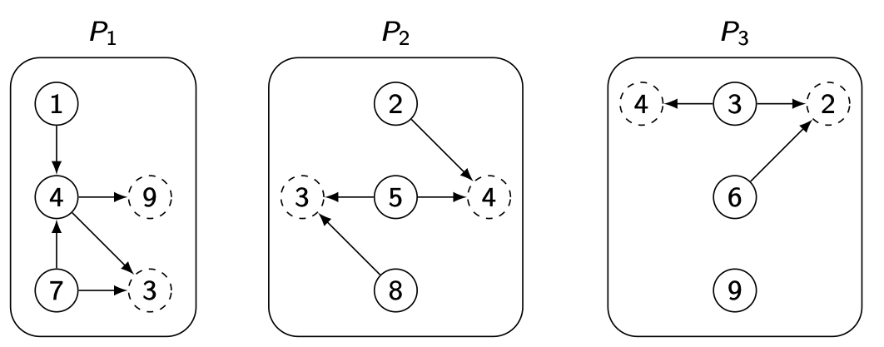
Edge-Disjoint Partitioning Example
➡

Slide 60
Can MapReduce be used for Graph Analytics?
map and reduce functions can be written for gaph analytics
There are works that have done this
Graph analytics tasks are iterative
Recall: MapReduce is not good for iterative tasks
Spark improves MapReduce (e.g., Hadoop) for iterative tasks
GraphX on top of Spark
Edge-disjoint partitioning
Vertex table & edge table as RDDs on each worker
Join vertex & edge tables
Perform an aggregation

Slide 61
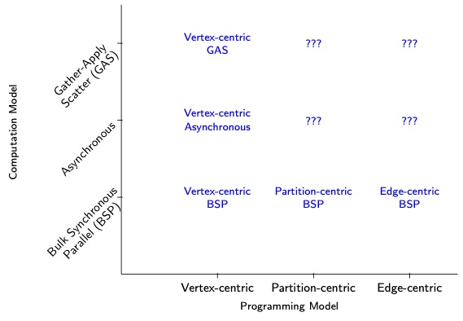
Special-Purpose Graph Analytics Systems
???: Systems do not exist

Slide 62
Vertex-Centric Model
Computation on a vertex is the focus
“Think like a vertex”
Vertex computation depends on its own state + states of its neighbors
Compute(vertex v)
GetValue(), WriteValue()

Slide 63
Partition-centric (Block-centric) Model
Computation on an entire partition is specified
“Think like a block” or “Think like a graph”
Aim is to reduce the communication cost among vertices

Slide 64
Edge-centric Model
Computation is specified on each edge rather than on each vertex or bloc
Compute(edge e)

Slide 65
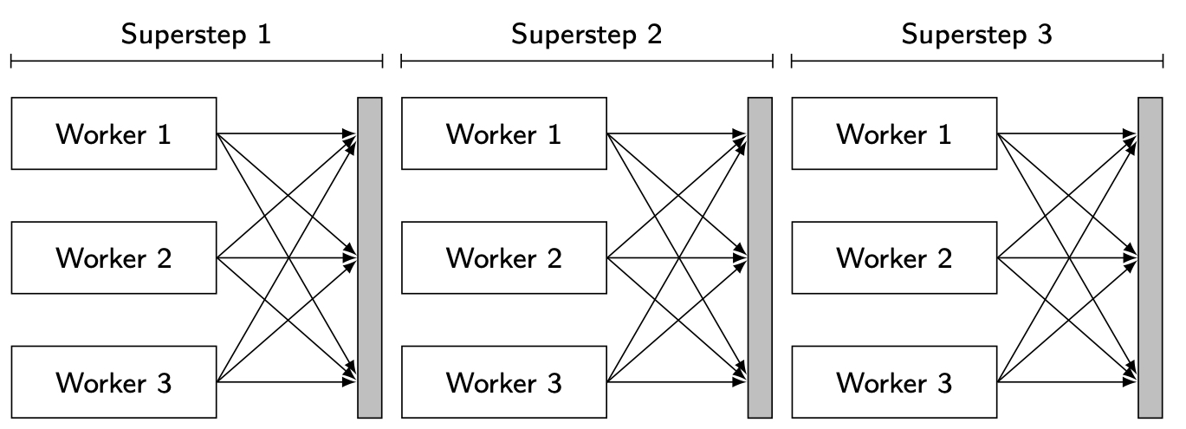
Bulk Synchronous Parallel (BSP) Model
Each machine performs
computation on its
graph partition
At the end of each superstep
results are pushed to other
workers

Slide 66
Asynchronous Parallel (AP) Model
Supersteps, but no communication barriers
Uses the most recent values
Computation in step k may be based on neighbor states of step k-1 (of received late) or of state k
Consistency issues → requires distributed locking
Consider vertex-centric

Slide 67
Gather-Apply-Scatter (GAS) Model
Similar to BSP, but pull-based
Gather: pull state
Apply: Compute function
Scatter: Update state
Updates of states separated from scheduling

Slide 68
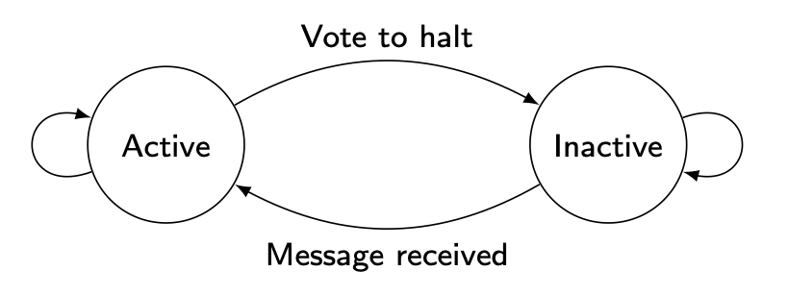
Vertex-Centric BSP Systems
“Think like a vertex”
Compute(vertex v)
BSP Computation – push state to neighbor vertices at the end of each superstep
Continue until all vertices are inactive
Vertex state machine

Slide 69
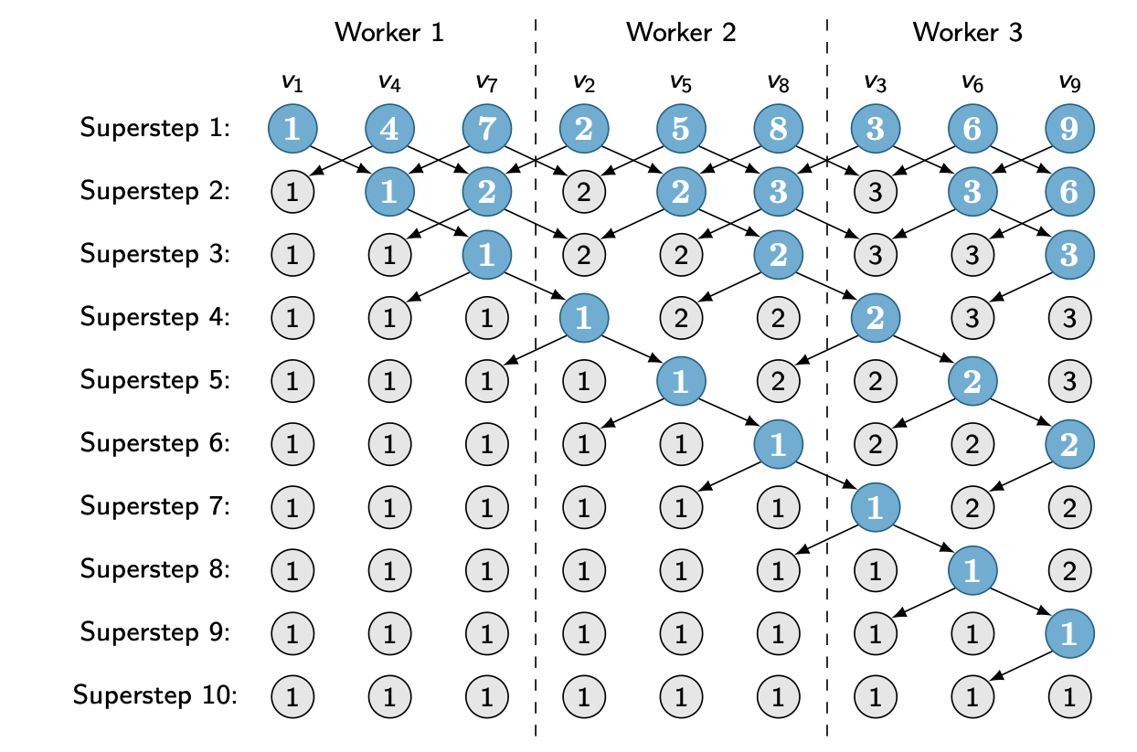
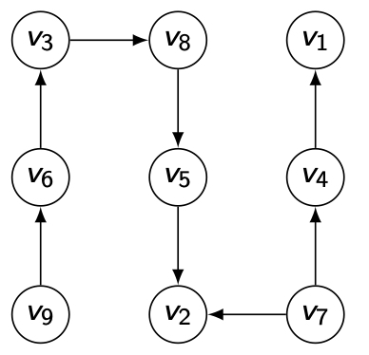
Connected Components: Vertex-Centric BSP

Slide 70
Vertex-Centric AP Systems
“Think like a vertex”
Compute(vertex v)
Supersteps exist along with synchronization barriers, but …
Compute(vertex v) can see msgs sent in the same superstep or previous one
Consistency of vertex states: distributed locking
Consistency issues: no guarantee about input to Compute()

Slide 71
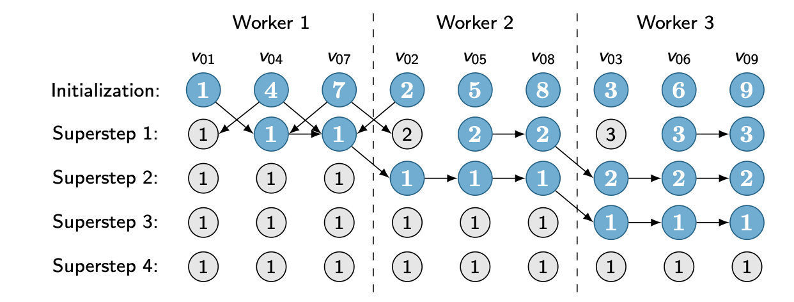
Connected Components: Vertex-Centric AP

Slide 72
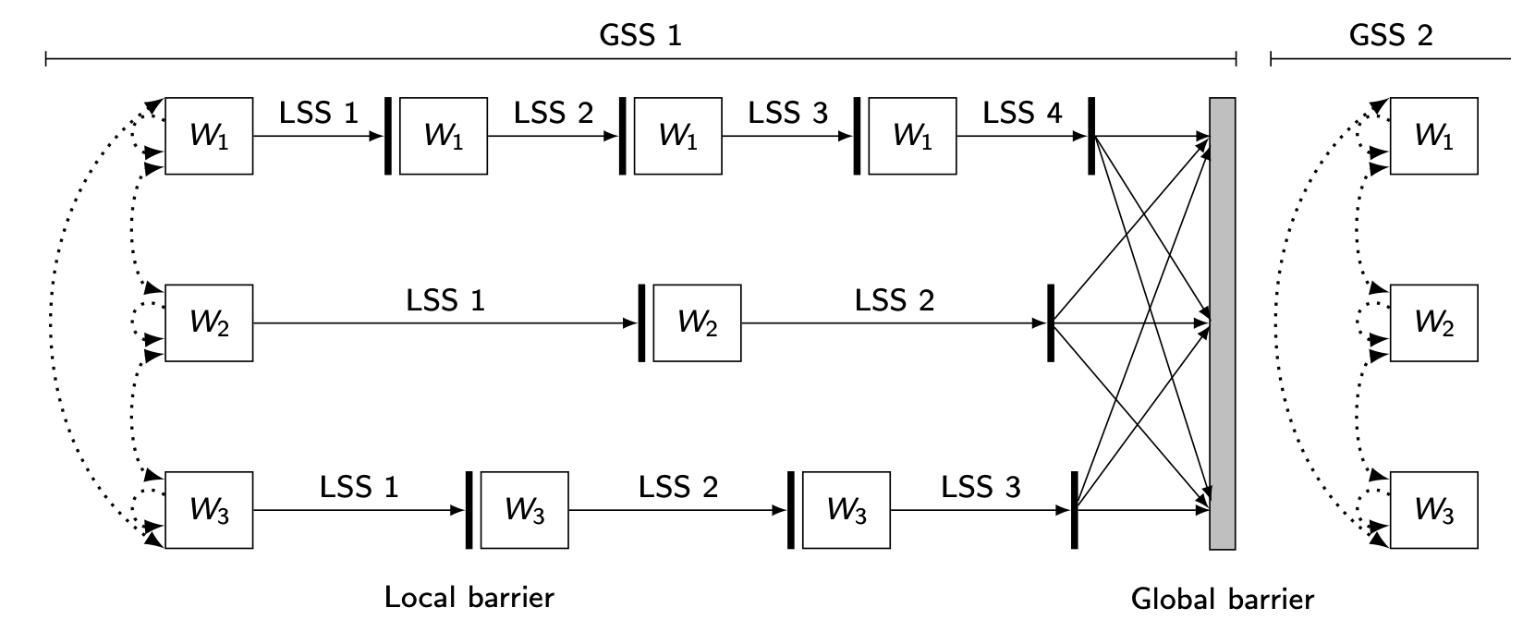
Barrierless Asynchronous Parallel (BAP)
Divides each global superstep into logical supersteps separated by very lightweight local barriers
Compute() can be executed multiple times in each superstep (once-per-logical superstep)
Synchronizes at global barriers as in AP

Slide 73
Partition- (Block-)Centric BSP Systems
“Think like a block”; also “think like a graph”
Reduces communication
Exploit the partitioning of the graph
Message exchanges only among blocks; BSP in this case
Within a block, run a serial in-memory algorithm

Slide 74
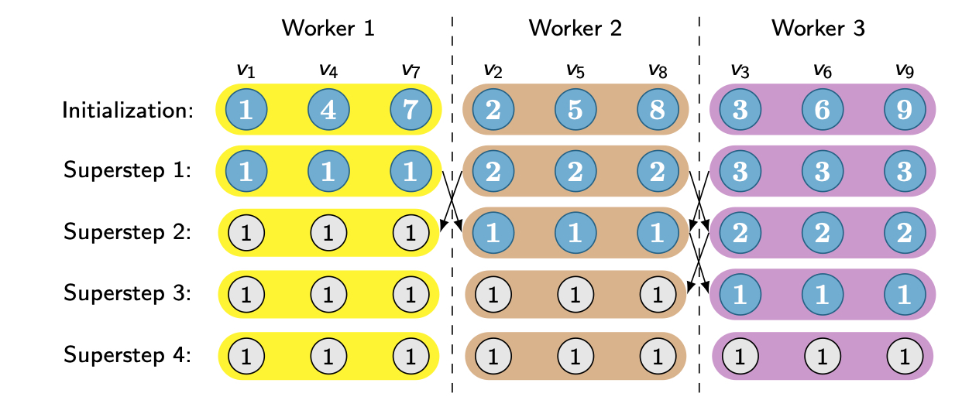
Connected Components: Block-Centric BSP

Slide 75
Edge-Centric BSP Systems
Dual of vertex-centric BSP
“Think like an edge”
Compute(edge e)
BSP Computation – push state to neighbor vertices at the end of each superstep
Continue until all vertices are inactive
Number of edges ≫ number of vertices
Fewer msgs, more computation
No random reads

Slide 76
Data Lake
Collection of raw data in native format
Each element has a unique identifier and metadata
For each business question, you can find the relevant data set to analyze it
Originally based on Hadoop
Enterprise Hadoop

Slide 77
Advantages of a Data Lake
Schema on read
Write the data as they are, read them according to a diagram (e.g. code of the Map function)
More flexibility, multiple views of the same data
Multi-workload data processing
Different types of processing on the same data
Interactive, batch, real time
Cost-effective data architecture
Excellent cost/performance and ROI ratio with SN cluster and open source technologies

Slide 78
Principles of a Data Lake
Collect all useful data
Raw data, transformed data
Dive from anywhere
Users from different business units can explore and enrich the data
Flexible access
Different access paths to shared infrastructure
Batch, interactive (OLAP and BI), real-time, search,.....

Slide 79
Main Functions
Data management, to store and process large amounts of data
Data access: interactive, batch, real time, streaming
Governance: load data easily, and manage it according to a policy implemented by the data steward
Security: authentication, access control, data protection
Platform management: provision, monitoring and scheduling of tasks (in a cluster)

Slide 80
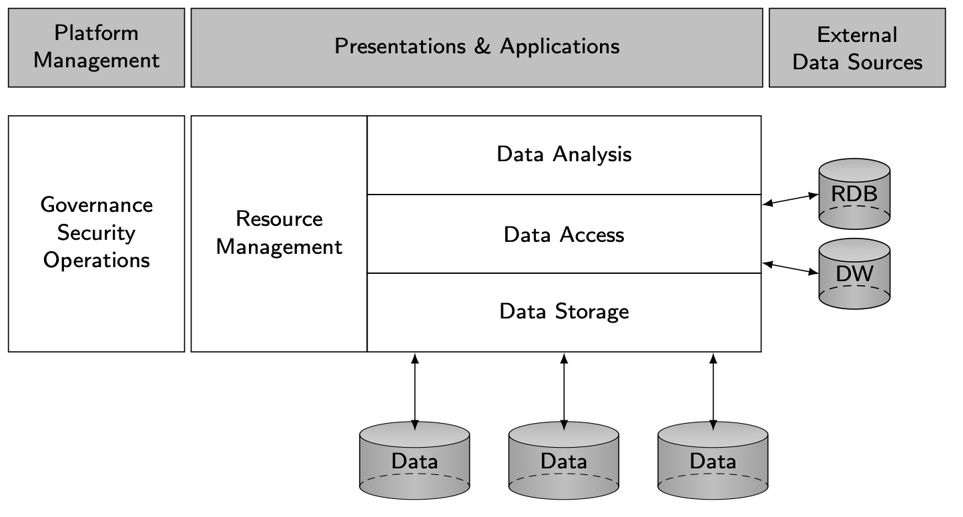
Data Lake Architecture
A collection of multi-modal data stored in their raw formats

Slide 81
Data Lake vs Data Warehouse
Data Lake
Data Warehouse
Shorter development process
Schema-on-read
Multiworkload processing
Cost-effective architecture
Long development process
Schema-on-write
OLAP workloads
Complex development with ETL

